Slide 1
Optimization of Drip Irrigation Systems Using Kubernetes Managed Edge Computing
Tasnim Fuyara Chhoan (23366035)
Abrar Al Sayem (18201194) Ripa Sarkar(23366009) Asika Islam (22273013) Mehnaz Ara Faizul (ST) Humaion Kabir Mehedi (RA)
Team-21

Slide 2
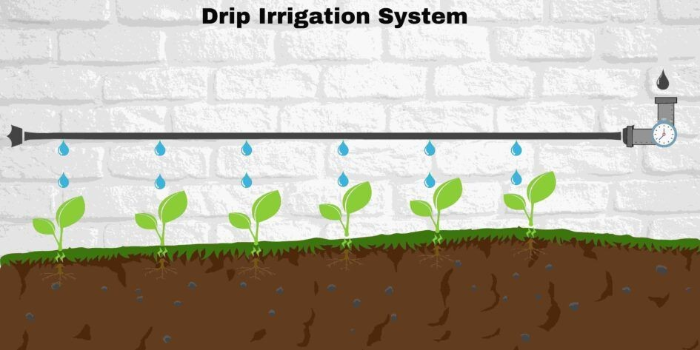
Introduction
Precision agriculture, notably through advanced drip irrigation systems, is revolutionizing farming. The focus here is on developing a Kubernetes-based framework to optimize these systems, leveraging Kubernetes' scalability and robustness to enhance irrigation efficiency and promote sustainable agriculture. This approach, backed by numerous studies, aims to further precision agriculture and tackle modern agricultural challenges.

Slide 3
LITERATURE REVIEW
Edge Computing in agriculture utilizes local processing in data sources,overcoming challenges posed by limited rural internet access. This approach, demonstrated in prototypical systems across various agricultural domains,enables real-time analytics and decision-making on Edge nodes. The agricultural industry has experienced a notable increase in the utilization of technologies like IoT, cloud computing,and artificial intelligence. Kubernetes has become a pivotal technology for overseeing distributed systems, especially in container orchestration explores the utilization of Kubernetes in high-performance computing systems, showcasing its effectiveness in orchestrating containerized applications. Kubernetes also focuses on advanced monitoring and management techniques for the clusters, particularly in the context of scientific computing and high-performance computing environments. This paper, introduces SLATE, a project aimed at accelerating collaborative scientific computing. It provides a secure container orchestration framework, particularly focusing on the Science DMZ to facilitate the creation of advanced multi-institution platforms and novel science gateways. This study proposes a new solution for automatic anomaly detection and alerting to aid system administrators in early detection and prevention of defects.

Slide 4
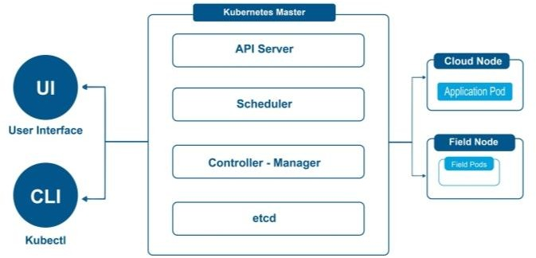
METHODOLOGY
This research focuses on developing a theoretical framework to incorporate Kubernetes into drip irrigation systems for advanced agriculture. Kubernetes an
open-source platform designed to automate the deployment, scaling, and operation of application containers across clusters of hosts controlled by kubernetes Master. It is the control plane of a Kubernetes cluster, responsible for managing its state and configuration. It includes several components: the API,the etcd storage, the schedule, and the controller manager.

Slide 5
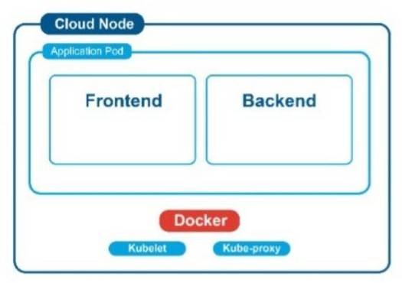
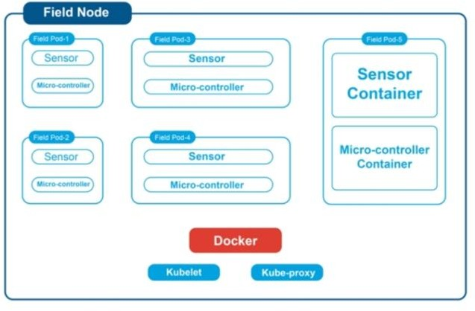
Nodes
Cloud Node is the central hub of the Kubernetes-based system. They host application pods that include both frontend and backend components, crucial for the system’s operation and user interaction.
Field Node is situated in the agricultural fields and con-sist of field pods equipped with various sensors and micro-controllers. In the node they are virtual representations of the group of IoT components.

Slide 6
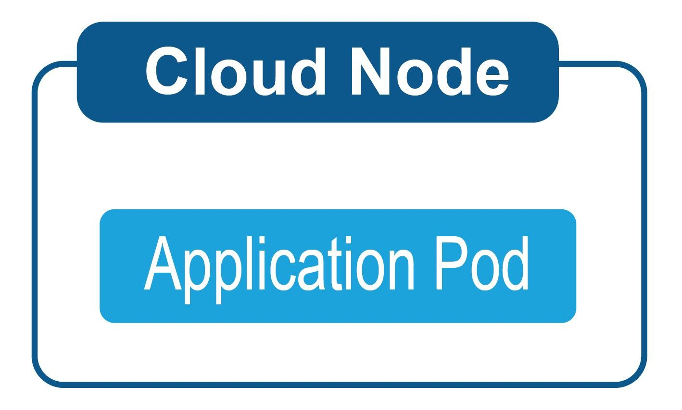
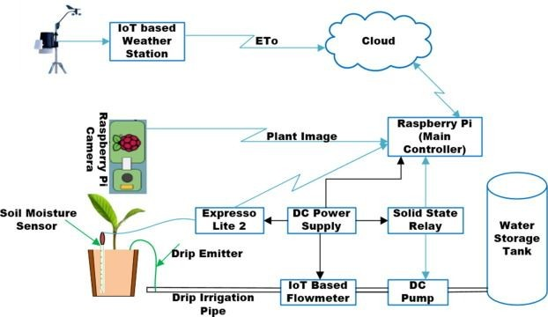
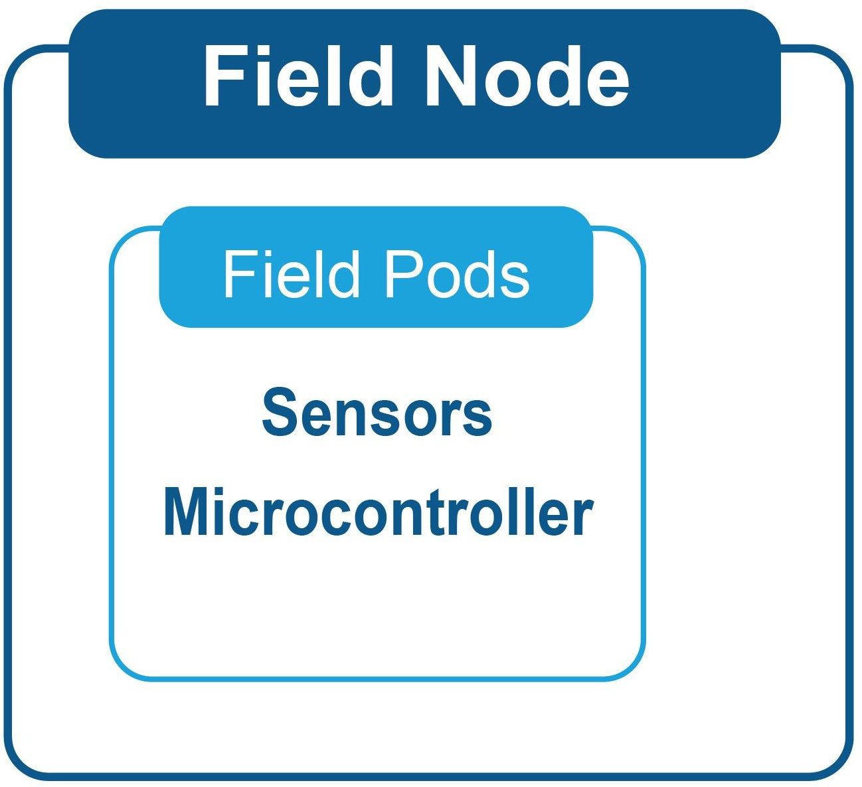
Kubernetes Managed Edge Computing for Irrigation

Slide 7
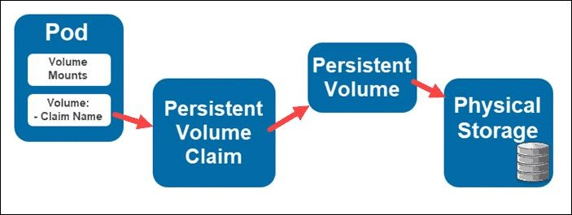
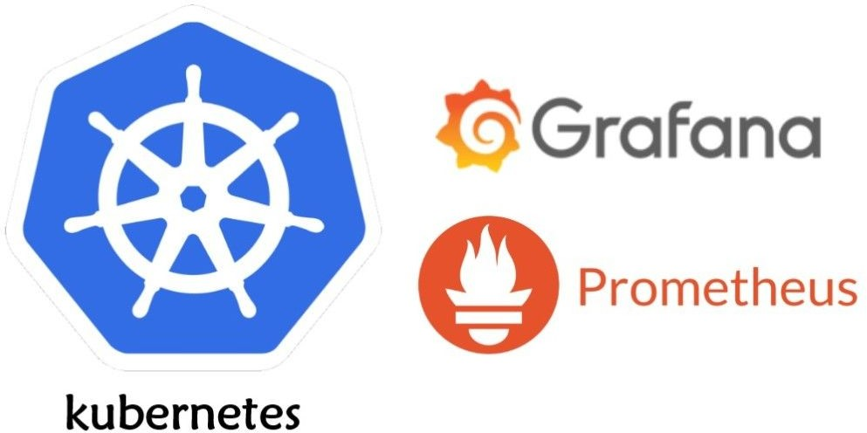
Data Storage and Prometheus
Data Flow
Persistent Volume
Prometheus
Grafana

Slide 8
Monitoring and Computational Analysis
The monitoring and computational analysis of Kubernetes-managed irrigation systems are fundamental to ensuring optimal performance and resource efficiency as well as anomalies detection.Utilizing tools like Prometheus and Grafana for monitoring, and analyzing parallel/distributed computation and high performance computation in edge computing, can significantly enhance the management of such systems. Kubernetes provides the tools necessary for dynamic resource allocation and scheduling, while Prometheus offers the monitoring capabilities needed to ensure the system operates at peak efficiency. Together, they create a responsive, efficient,and reliable infrastructure that can adapt to the demands of modern precision agriculture.

Slide 9
Conclusion
The paper highlights the innovative use of Kubernetes in edge computing for enhancing drip irrigation systems in precision agriculture. It details how Kubernetes' architecture effectively manages distributed nodes for real-time data processing, offering better load balancing, self-healing, automated rollouts, and scalability compared to alternatives such as; Amazon ECS, Nomad etc. The system leverages Kubernetes pods for sensor data management and containerizes irrigation monitoring components, ensuring modularity and scalability. Key to this system are monitoring and computational analysis, with tools like Prometheus and Grafana used for real-time data visualization and alerting, enabling the system to respond to current conditions and predict future needs. However, challenges such as implementation complexity, high initial setup costs, and the need for technical expertise are significant. Additionally, broader adoption raises issues regarding cybersecurity, data privacy, and the need for fault-tolerant designs to adapt to the unpredictable agricultural environment.

Slide 10
THANK YOU

